Slide 1
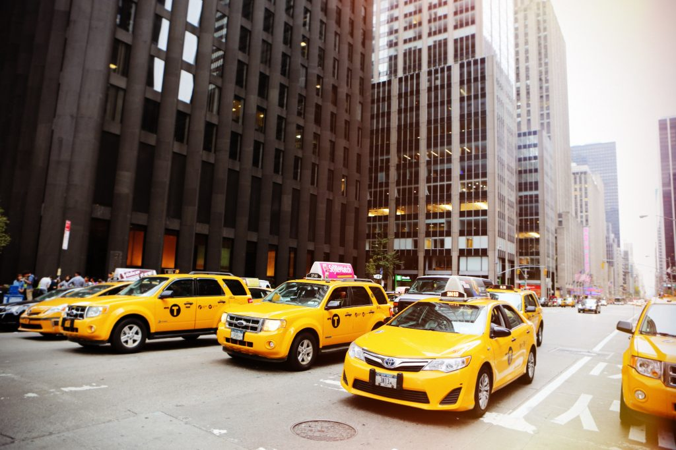

Group 10
Xavier Souffront
Jason Gullapa
Sara Wexler
Kazi Farhan Hoque

Slide 2
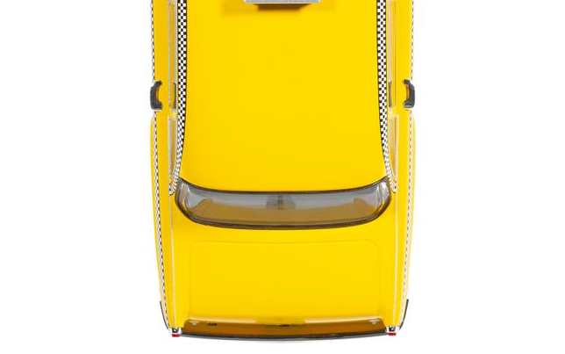

Table of Contents
03 Background
The Data and Business Problem
04 Insight 1
Taxi Trip Market Share
05 Insight 2
Monthly Volume of Taxi Trips
06 Insight 3
Impact of Weather on Taxi Trips
07 Recap
Value of insights
Final recommendations
Notes:
Here is our agenda for today

Slide 3
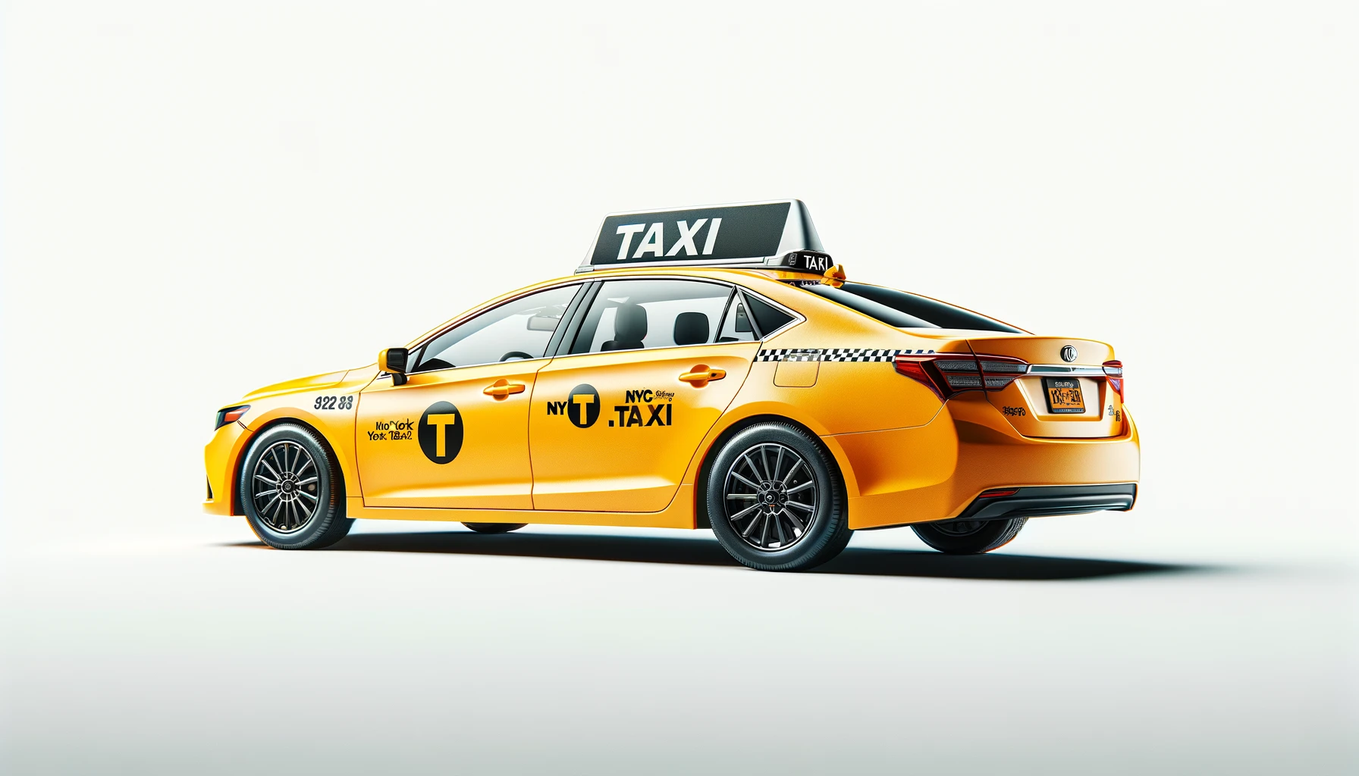
Background
Data from Taxi and Limousine Commission (TLC)
“Over 200,000 TLC licensees complete approximately 1,000,000 trips each day.” *
Business Problem:
What are the drivers behind the reduced revenue?
How can this be resolved?
*https://www.nyc.gov/site/tlc/about/about-tlc.page
Notes:
We collected data from a NYC Government Agency: Taxi and Limousine Commission (TLC)
We want to solve the challenge of understanding and resolving… what is eating up at their revenue

Slide 4
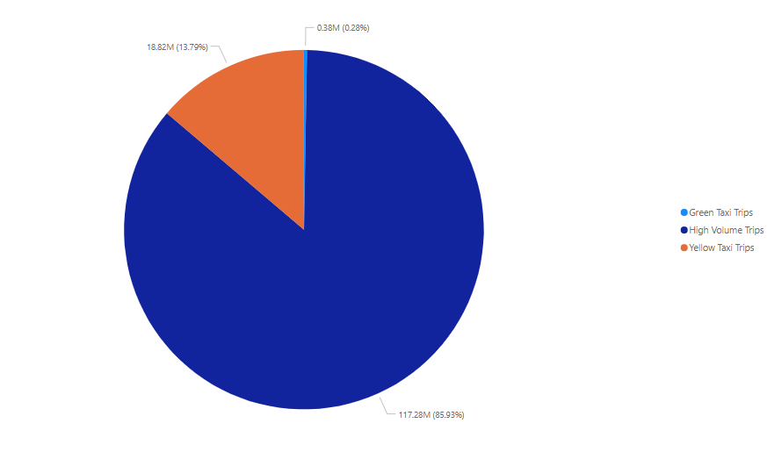
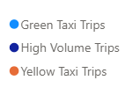
Insight 1: Total Trip Market Share
Notes:
Intro: Many trips are requested and completed in all 5 boroughs
Recorded into 3 categories: Yellow Taxi, Green taxi, and High Volume Trips
HV are Ubers, Lyfts, and other ride sharing apps
~HV Trips take a 86% share, Yellow taxi ~14%, and Green taxi barely a %
TLC needs to make more taxis available and spread throughout the 5 boroughs to compete better

Slide 5
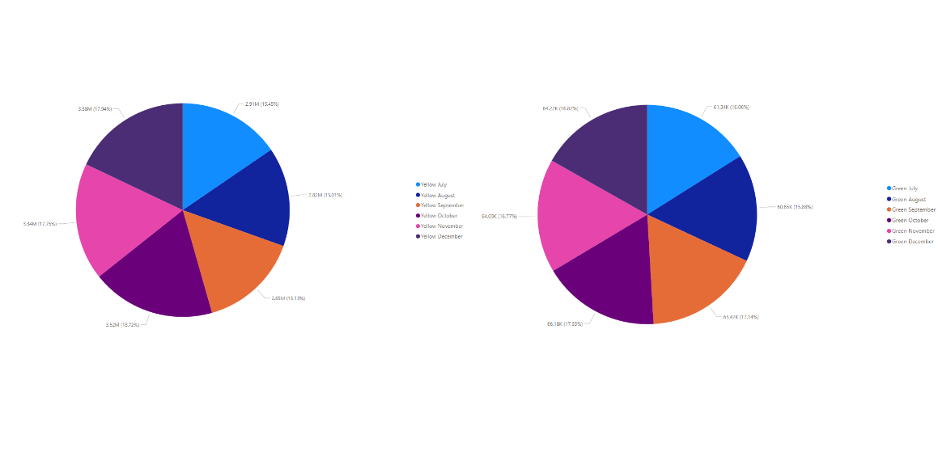
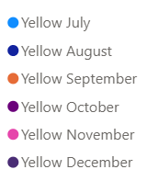
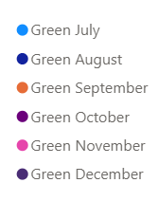
Insight 2: Monthly Volume of Taxi Trips
Yellow Taxi
Green Taxi
Notes:
Both yellow and green taxis are regulated by TLC
Yellow Taxi
operates everywhere in NYC (in all 5 boroughs)
serves high-demand areas, including tourist spots and business districts
Green Taxi
Was created to to extend taxi service to underserved areas where yellow taxis wouldn’t go
Only accessible in Manhattan and the outer boroughs, but is restricted from picking up passengers south of East 96th Street and West 110th Street.
Both charts show that yellow and green taxi trips do not vary based on season
They have similar amounts but on a different scale - Yellow is in millions and green is in thousands

Slide 6
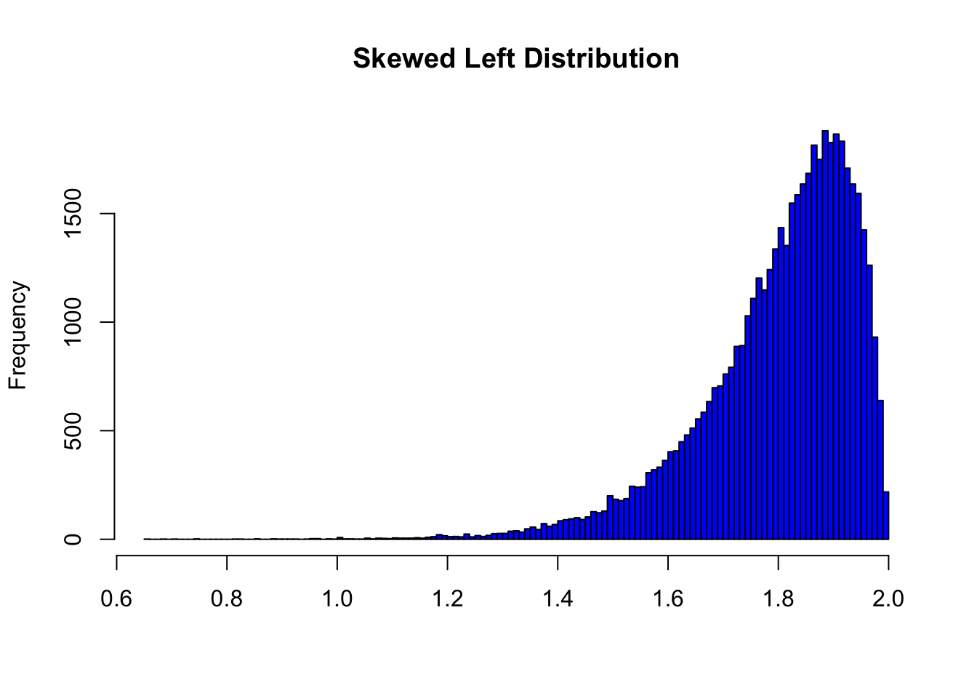
Insight 3: Weather Influence on Taxi Trips
Notes:
3 of the four hottest months of the year (July, August, September)
Missing 3 of the four coldest months of the year (Jan., Feb., March).
Why does this matter?
Dataset will continue heavier volume towards warmer months
Leaves out our colder months
No clear conclusion
But we can observations
January 39 / 26
February 40 / 27
March 48 / 34
April 61 / 44
May 71 / 53
June 81 / 63
July 85 / 68
August 83 / 66
September 77 / 60
October 67 / 51
November 54 / 41
December 41 / 30

Slide 7
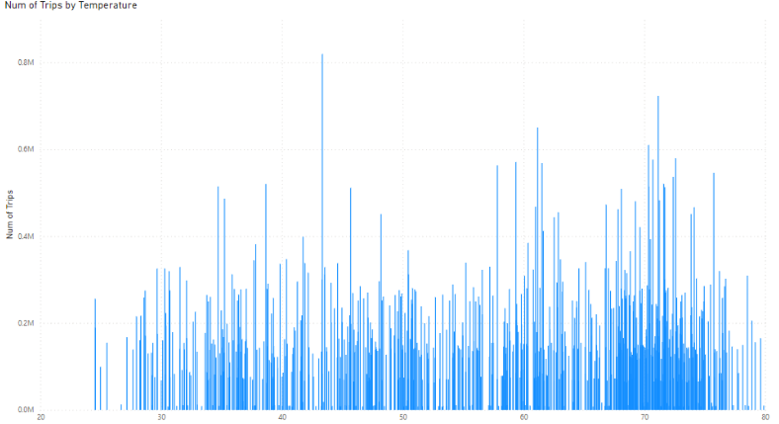
Insight 3: Weather Influence on Taxi Trips (HV)
Notes:
3 of the four hottest months of the year (July, August, September)
Missing 3 of the four coldest months of the year (Jan., Feb., March).
Why does this matter?
Dataset will continue heavier volume towards warmer months
Leaves out our colder months
No clear conclusion
But we can observations
January 39 / 26
February 40 / 27
March 48 / 34
April 61 / 44
May 71 / 53
June 81 / 63
July 85 / 68
August 83 / 66
September 77 / 60
October 67 / 51
November 54 / 41
December 41 / 30

Slide 8
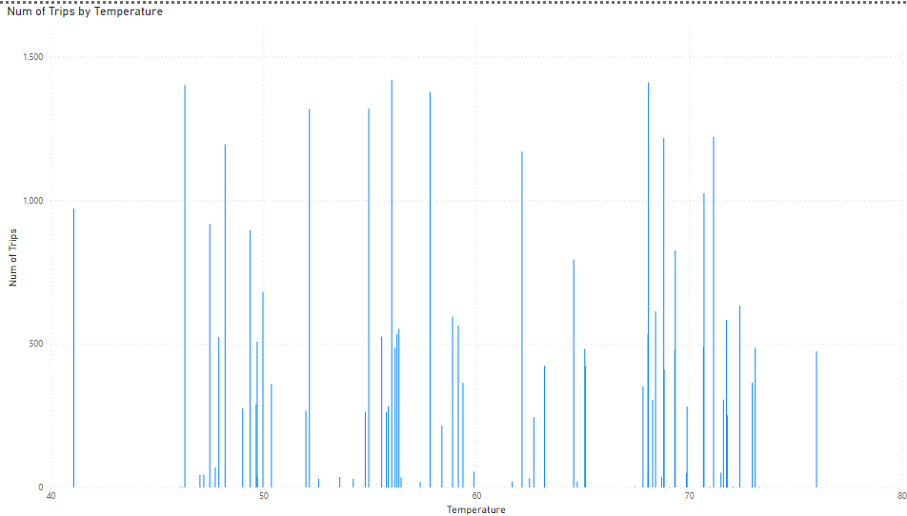
Insight 3: Weather Influence on Taxi Trips (Green)

Slide 9
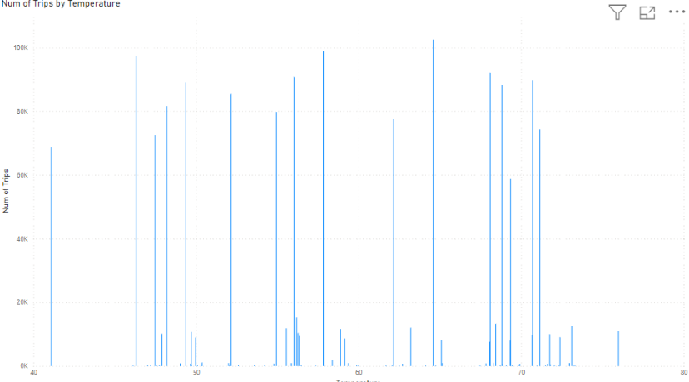
Insight 3: Weather Influence on Taxi Trips (Yellow)

Slide 10
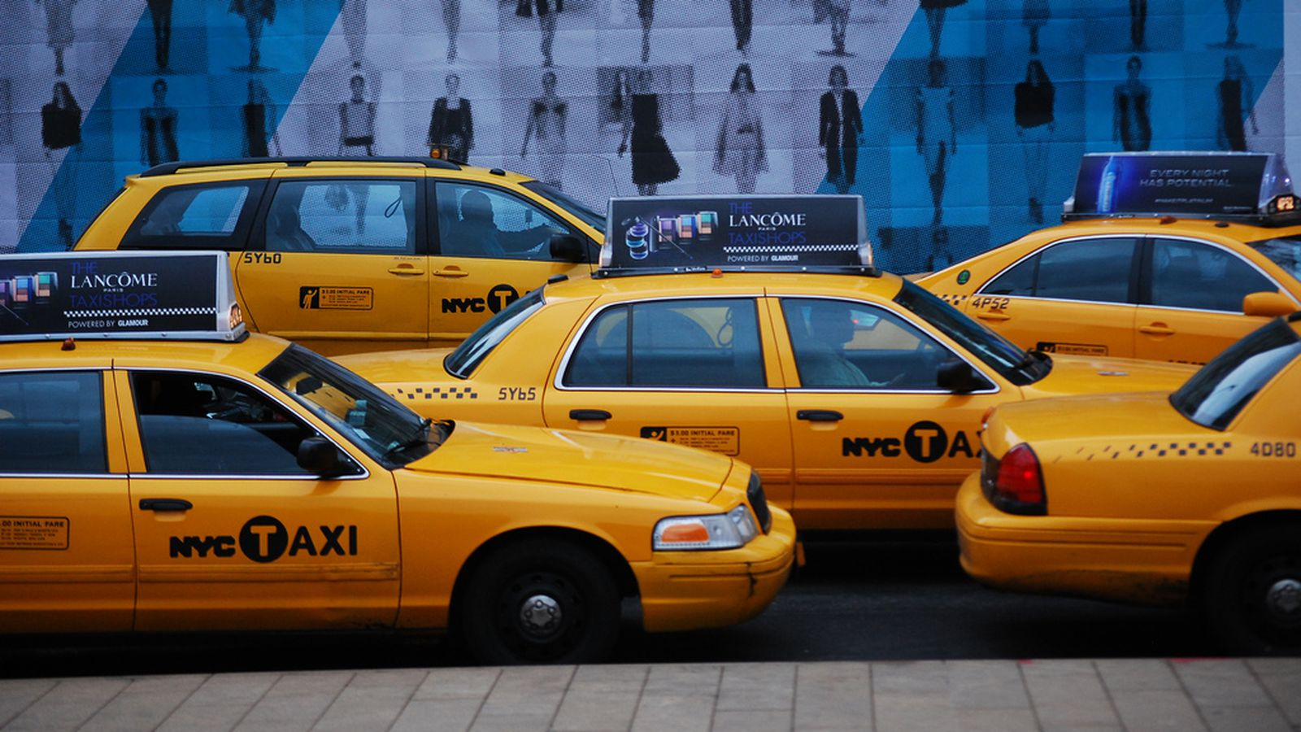

Recap
Ride sharing vehicles take larger portion of market share
Seasonality does not affect TLC
Warmer climate does not affect TLC
Can take more risky approaches:
More designated taxis, spread throughout the 5 boroughs
Create own ride sharing app

Slide 11
Thank You

